Slide 1
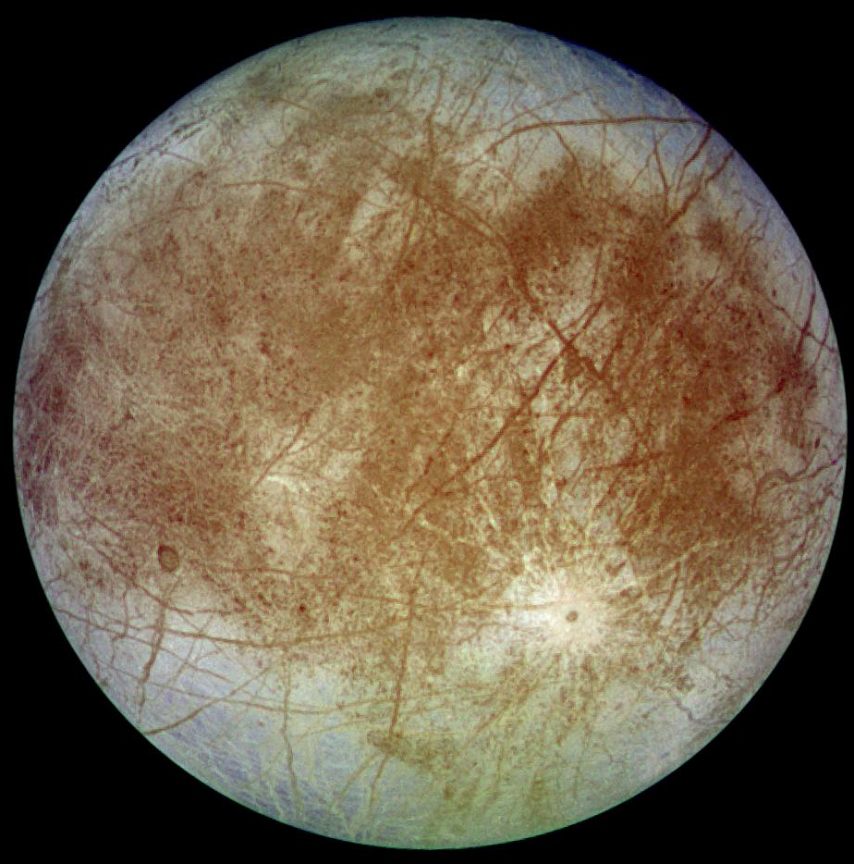
Europa
Radius:
1,560.8 km
Discovered in 1610 by Galileo Galilei
Sunlight arrives in 45 minutes
Orbital Period:
3.55 Earth days
Mass: 4.7x10²² kg

Slide 2
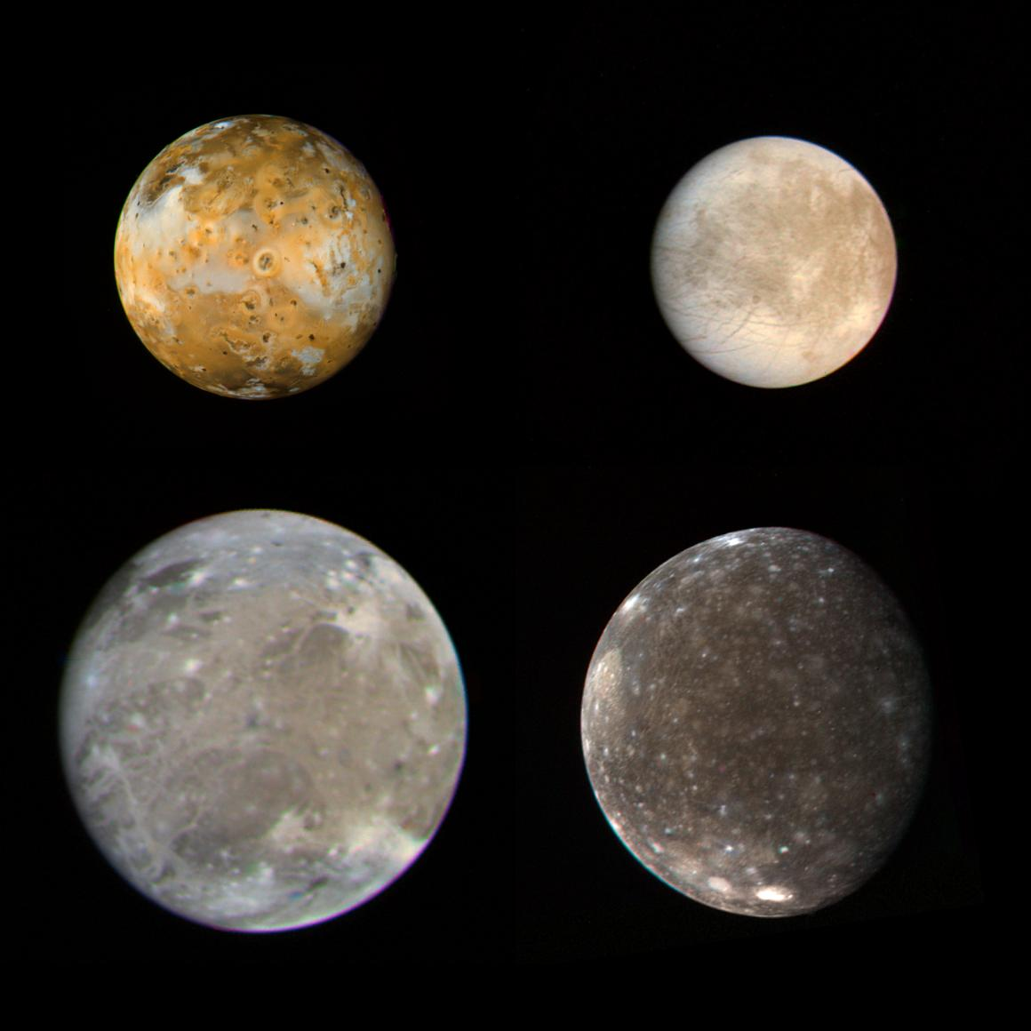
Io
Radius:
1,821.6 km
Discovered in 1610 by Galileo Galilei
Sunlight arrives in __ minutes
Orbital Period:
1.77 Earth days
Mass:
8.9x10²² kg

Slide 3
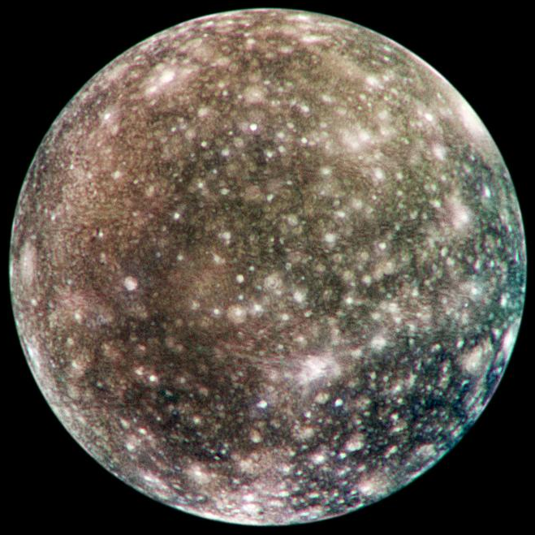
Callisto
Radius: 2,410.3 km
Discovered in 1610 by Galileo Galilei
Sunlight arrives in __ minutes
Orbital Period:
16.69 Earth days
Mass:
10.8x10²² kg

Slide 4
Ganymede
Radius:
2,631.2 km
Discovered in 1610 by Galileo Galilei
Sunlight arrives in __ minutes
Orbital Period:
7.15 Earth days
Mass:
14.8x10²² kg

Slide 5
References
Io and Ganymede- https://pds-rings.seti.org/press_releases/pages/PIA00xxx/PIA00023.html
Europa - https://pds-rings.seti.org/press_releases/pages/PIA00xxx/PIA00502.html
Callisto - https://pds-rings.seti.org/press_releases/pages/PIA03xxx/PIA03456.html
https://nssdc.gsfc.nasa.gov/planetary/factsheet/joviansatfact.html

Slide 6
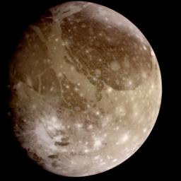
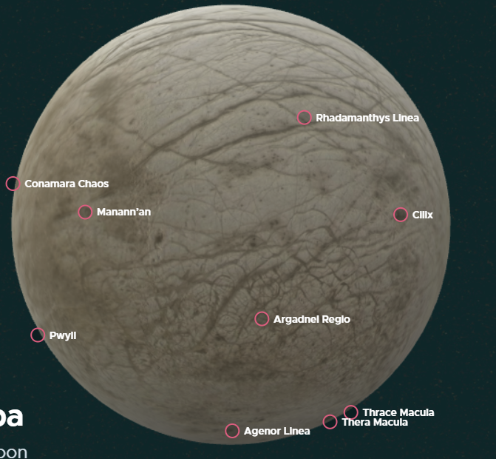
option
Ganymede - https://pds-rings.seti.org/press_releases/pages/PIA00xxx/PIA00716.html
https://solarsystem.nasa.gov/moons/jupiter-moons/europa/in-depth/

Slide 7
Background
1. Missions that explored the moon
2. fact relevant to game mission
3. fact relevant to game mission 2
4. fun fact

Slide 8
Europa
1. Voyager and Galileo missions. Hubble Space Telescope
2. Water-rich and warm interior could be hospitable to life
3.
4. almost the size of Earth’s Moon.
https://space-facts.com/moons/europa/
Magnetic field exists, meaning conductive beneath ice (salt water)
https://solarsystem.nasa.gov/moons/jupiter-moons/europa/in-depth/
Spectrograph at Keck Observatory to measure water vapor above Europa. Infrared light emit or absorb.
Ice shell probably 15-25 km thick.

Slide 9
Io
1. Voyager, Cassini, Galileo, New Horizons
2. most volcanically active body in the solar system. >400 active volcanoes
3. volcanic plums up to 200hm high, sulfur, sulfur dioxide, rocky ash
4.
https://space-facts.com/moons/io/
https://en.wikipedia.org/wiki/List_of_volcanic_features_on_Io
https://solarsystem.nasa.gov/moons/jupiter-moons/io/overview/
Lakes of molten silicate lava

Slide 10
Callisto
https://space-facts.com/moons/callisto/
Surface has water ice, CO2 ice, silicate dust, rock particles, hydrocarbon compounds. Interior ocean.
Most heavily cratered surface of a world in the solar system
Missions that have explored Callisto: Pioneer, Voyager, Galileo, Cassini, New Horizons
https://solarsystem.nasa.gov/moons/jupiter-moons/callisto/in-depth/
About the size of Mercury
Suspected subsurface ocean – potential for life. Oxygen detected in exosphere

Slide 11
Ganymede
1. Hubble Space Telescope, Pioneer 10, Voyager, Galileo, New Horizons, Juno
2.
3.
4.
https://space-facts.com/moons/ganymede/
Largest moon in the solar system, larger than Mercury.
Strong magnetosphere so thought to have subsurface ocean over liquid iron and nickel core
https://solarsystem.nasa.gov/moons/jupiter-moons/ganymede/in-depth/
Only moon with it’s own magnetic field. auroras – glowing electrified gas
Underground saltwater ocean suspected. More water than all Earth’s surface.
Thick ice shell about 800km thick.

Slide 12
Jupiter
https://solarsystem.nasa.gov/moons/jupiter-moons/europa/in-depth/
Jupiter takes 4,333 Earth days to orbit the Sun
Jupiter’s moons Io, Europa, and Ganymede are in what is called a resonance – every time Ganymede orbits Jupiter once, Europa orbits twice, and Io orbits four times
Callisto, (and others) tidally locked so same side always facing Jupiter
Strong magnetic field to consider
These 4 Jovian moons were the first moons discovered orbiting a planet other than Earth. Led to heliocentricism.
Other Link

Slide 13
Europa

Slide 14
Io

Slide 15
Callisto

Slide 16
Ganymede

